Slide 1

Adaptive Personalization in Social Media
First review - Batch 8
Team Members:
Deepthishree G S (18Z312)
Harshini S (18Z320)
Suvalakshmi B (18Z359)
Swetha M (18Z360)
Thendral PK (18Z362)
Guide: Dr. N. Gopika Rani

Slide 2
Problem Domain: AI, Social Media Analysis
Now a days, social media constitutes a significant part of time for users.
The home feed often consists of a variety of unrelated posts and feed which might make the UX bad.
The problem is to provide a customised and personalised feed for the user based on the cue (More stories like this selected by user or Not Interested).
Currently, the feed is primarily based on the interests and user accounts followed manually by user.
Personalising and adapting might make his/ her feed much more relatable and user-friendly.
Problem Definition

Slide 3
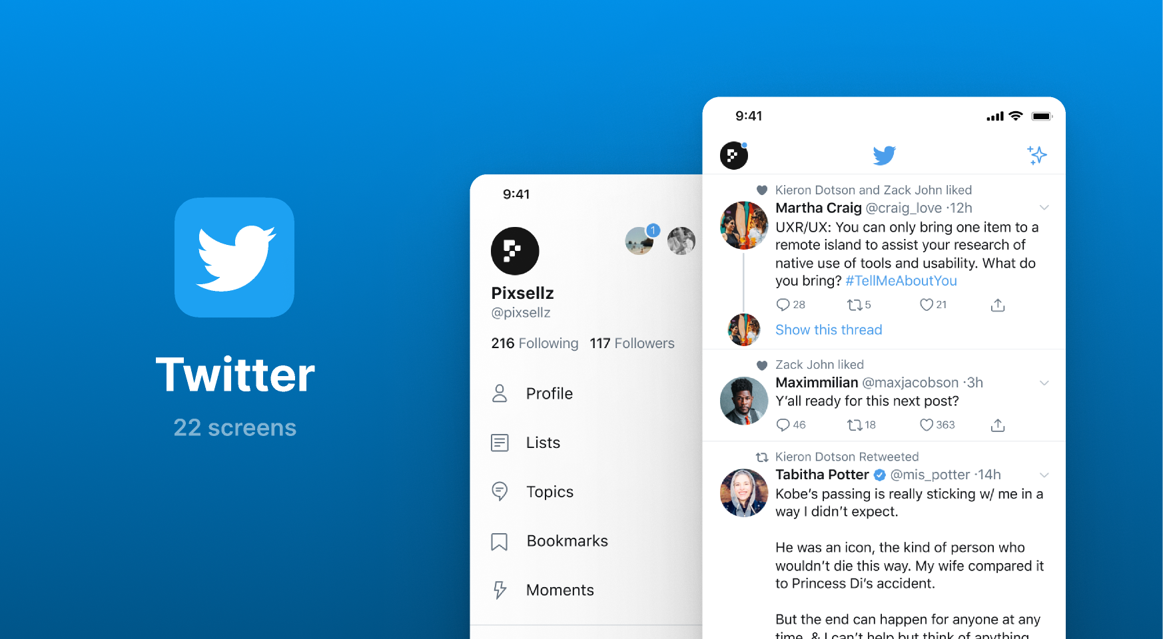
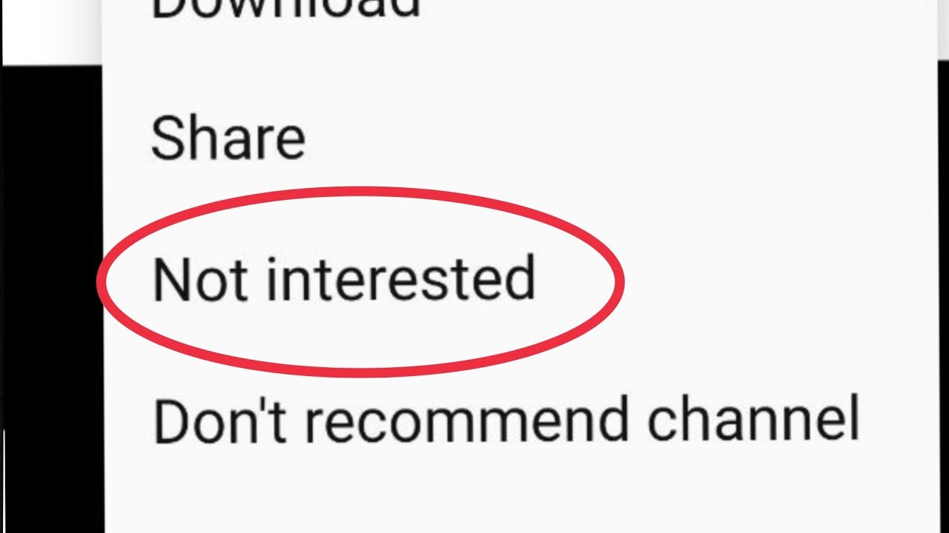

Slide 4
To develop an application for displaying user feed and getting user intent (training data generation)
To develop a model for deciding to include or discard the post from feed (customised feed)
To implement the system as a scalable and usable system which can be used for any social media
Objective

Slide 5
Literature Survey
Title | Author | Journal | Algorithms Used | Advantages | Disadvantages
Adaptive personalization using social networks (2016) | Tuck Siong Chung, Michel Wedel & Roland T. Rust | J. of the Acad. Mark. Sci. | Bayesian Models | The performance of the system improves with number of keywords. | There are better algorithms for finding personalised news items.
Item-based Collaborative Filtering Recommendation Algorithm Combining Item Category with Interestingness Measure (2012) | Suyun Wei, Ning Ye, Shuo Zhang , Xia Huang, Jian Zhu | International Conference on Computer Science and Service System | Collaborative filtering algorithm based on item category and interest measure (CICF) | Better quality than traditional algorithm. | Combining different attributes of users and items is a challenging area.

Slide 6
Literature Survey
Title | Author | Journal | Algorithms Used | Advantages | Disadvantages
Personalized Recommendation Combining User Interest and Social Circle (2013) | Xueming Qian, He Feng, Guoshuai Zhao, Tao Mei | Ieee Transactions on Knowledge and Data Engineering | Matrix factorisation, CircleCon Model, ContextMF model | Improved accuracy and applicability of the recommender system. | Considers only user historical rating records and interpersonal relationship.
Reinforcement learning for personalization: A systematic literature review (2020) | Floris den Hengst, Eoin Martino Grua, et al | IOS Press and Authors | Reinforcement Learning | The behavior can be tailored for individual users. | Large no of possible states/state-action pairs has to be considered
Collective Knowledge Ontology User Profiling for Twitter - Automatic User Profiling (2013) | Paula Peña, Rafael del Hoyo, Jorge Vea-Murguía, et al | 2013 IEEE/WIC/ACM | Ontology Web Language or Resource Description Frame-work/XML format | To get a improved and enriched user profiling. | Require store, analyze and process large amount of data in distributed databases

Slide 7
Inference from existing works
The existing works are siloed and mostly not available as a complete system.
The social media personalisation is mostly proprietary and the algorithms are not published.
Inference & Proposed Work
Proposed Work
To use algorithms to calculate the score of being relatable to user.
To use reinforcement based algorithm to give rewards and penalties each time the post is added to refine the model and learning.
To use NLP based neural network to categorise the post
To use social profiling to keep track of user intents.
To implement hybrid approach or voting ensemble.

Slide 8
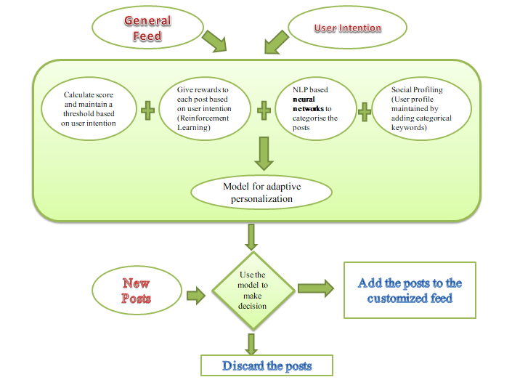
System Analysis and Design

Slide 9
Hardware and Software Requirements
Hardware Requirements:
Minimum 4GB RAM
Minimum i3 core processor to run ML algorithms
Minimum 3GB to store large data
Cloud storage and processing along with deployment can be used.
Software Requirements:
ML libraries like TensorFlow, keras
Web development techstack
Libraries to implement Matrix and Eigen based algorithms, reinforcement learning etc.

Slide 10
Scrapped data using Twint tool
Advantage: Large datasets with small script along with search and filters
Size of 15000 tweets sampled
Datasets from kaggle
Official Developer API for social media applications
Dataset details

Slide 11
Collected Dataset and a method to scrap from social media
Literature survey
System design and approaches possible
Implemented a simple text classifier with sample data
(The above can be improved with categories or reinforcement based feedback.)
Work Done So Far

Slide 12


2nd week of March - 1st week of April
1st week of May - 2nd week of May
Finalize the model
Implementation of the model
Documentation
Timeline
3rd week of Feb- 1st week of March
2nd week of April - 4th week of April
Problem Statement
Literature Survey
Collection of Dataset
Finish Implementation
Observe and improve the accuracy

Slide 13
Chung, T.S., Wedel, M. & Rust, R.T, “Adaptive personalization using social networks,” J. of the Acad. Mark. Sci, vol. 44, pp. 66–87, 2016.
Stephan Winter, Ewa Maslowska, Anne L. Vos, “The effects of trait-based personalization in social media advertising,” Computers in Human Behavior, vol. 114, pp. 106525, 2021.
Qian, X., Feng, H., Zhao, G., & Mei, T. “Personalized Recommendation Combining User Interest and Social Circle,” IEEE Transactions on Knowledge and Data Engineering, 26(7), pp. 1763–1777, 2014.
Wei, S., Ye, N., Zhang, S., Huang, X., & Zhu, J, “Item-Based Collaborative Filtering Recommendation Algorithm Combining Item Category with Interestingness Measure,” 2012 International Conference on Computer Science and Service System, 2012.
Shawky, D., & Badawi, A, “Towards a Personalized Learning Experience Using Reinforcement Learning,” Studies in Computational Intelligence, pp. 169–187, 2018.
Dominic Paul Rout, “A Ranking Approach to Summarising Twitter Home Timelines ,” Ph.d. thesis, The University of Sheffield, United Kingdom, 2015.
Paula Peña, Rafael del Hoyo, Jorge Vea-Murguía, Carlos González, Sergio Mayo, “Collective Knowledge Ontology User Profiling for Twitter Automatic User Profiling ,” 2013 IEEE/WIC/ACM International Conferences on Web Intelligence (WI) and Intelligent Agent Technology (IAT), pp. 439-444, 2013.
References

Slide 14


